Slide 1
CO-WANDA
COnvention for WAste management for inland Navigation on the DAnube
Hans Berger, viadonau - AT
Belgrade, 27.03.2014

Slide 2
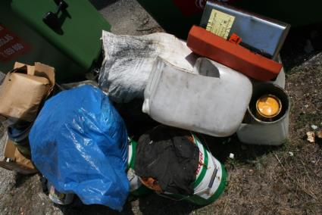
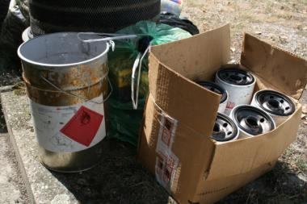
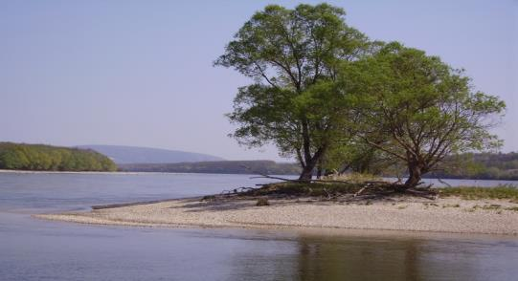
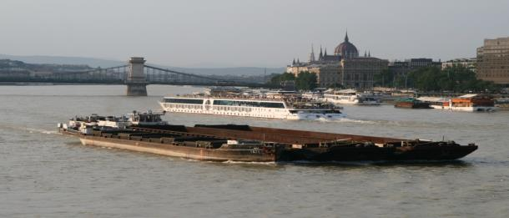
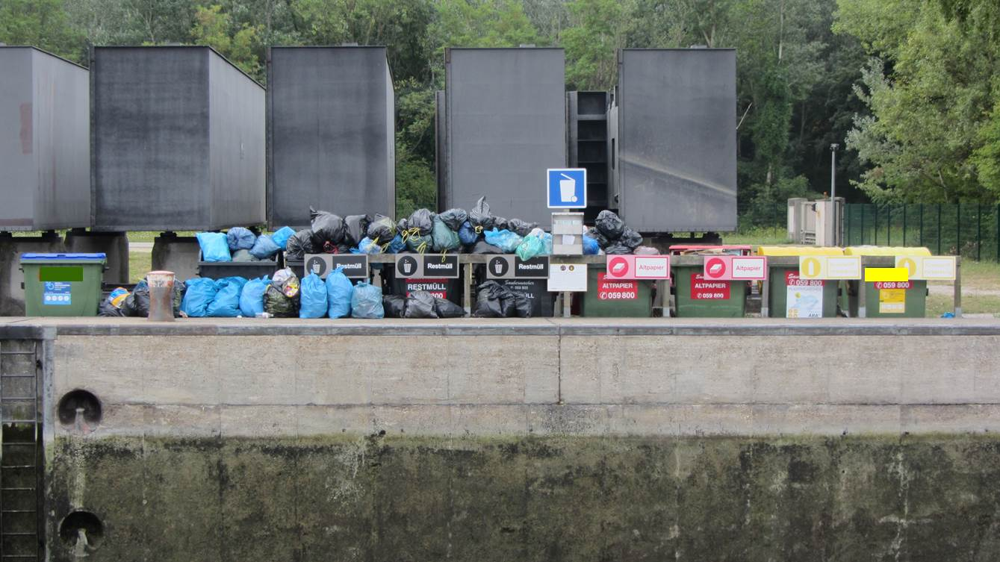
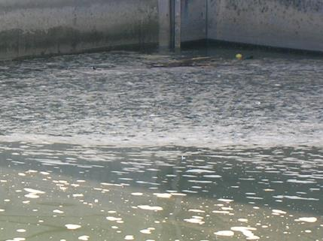
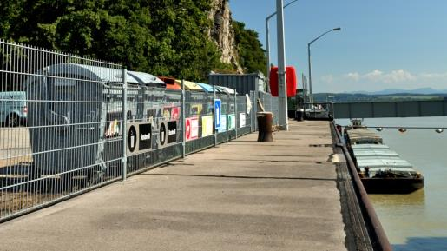
Goal: Harmonised Danube Ship Waste Management System
„Transport is fundamental to our economy and society…“
„The future prosperity of our continent will depend on the ability of all of its regions to remain […] integrated in the world economy. Efficient transport is vital in making this happen.“
„Transport has to use less and cleaner energy, better exploit a modern infrastructure and reduce its impacts on environment and key natural assets like water land and ecosystems.“
„Curbing mobility is not an option.“
quotes: White Paper, COM (2011) 144 final

Slide 3
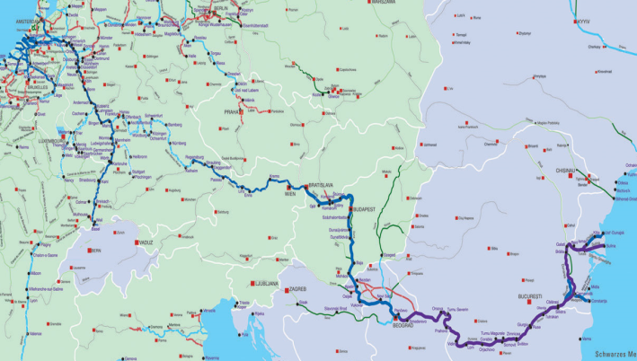

Frame Conditions
Legally binding rules
CDNI Waste Treaty
Danube Commission Recommendations
MARPOL
Different national systems
ISRBC
+ European Union (e.g. Waste Framework
Directive 2008/98/EC, EC 1013/2006, Water Framework Directive, Danube River Protection Convention)
+ CEVNI* Chapter 10
*CEVNI – Code Européen des Voies de la Navigation Intérieure -
European Code for Inland Waterways
+ Basel Convention

Slide 4
Basic Conditions
Legal framework is diverse & split
Different technical systems used for
        Waste disposal
        Re-financing of the costs
Vessels are not allowed to dispose their waste in every country!
Delivering waste might be time consuming or impossible risk of illegal discharges

Slide 5
Development
Mid 1980s: Danube commission recommendations
1999-2000: PHARE „Ship borne oily water and waste on the Danube: Feasibility Study”; Area: all Danube Riparian Countries
2003 – 2005: “Sustainable and EU conform collection and treatment of wastes from inland navigation on the Upper Danube”
National projects & efforts
2009 – 2012: WANDA: Project Partners from 7 countries:
Aim: Development of an internationally harmonised ship waste management system along the Danube
National level: Ship Waste Concepts, Pilot Tests, Financing
International Coordination
2012 – 2014: CO-WANDA: Partners from 9 countries

Slide 6


Development (2)

Slide 7
Key Factors
Awarness raising & support of skippers
International Danube Ship Waste Convention
User-friendly, Waste Reception Facilitities
Harmonised
Financing Model
Control Systems
Legal Framework
Socio-Economic Conditions
Technical Possibilities

Slide 8
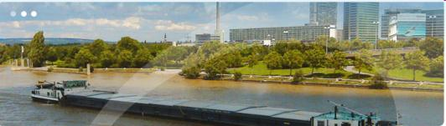
Goals of CO-WANDA
Prepare an international agreement for ship waste management
Continue close cooperation with ITW (skippers, fleet operators, ports, authorities, commissions)
Follow a practical approach
Elaborate the „technical groundwork“
The Danube is an international waterway!
The delivery of ship wastes shall be possible along the whole waterway for all vessels on equal terms!
The Danube is an international waterway!
The delivery of ship wastes shall be possible along the whole waterway for all vessels on equal terms!

Slide 9

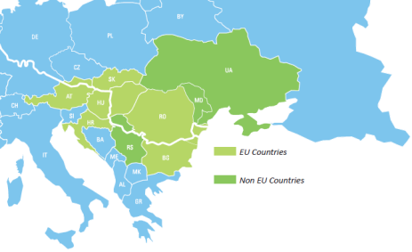


COnvention for WAste management for inland Navigation on the DAnube
Run time: October 2012 – September 2014
12 Partners from AT, SK, HU, HR, RS, RO, BG, MD, Ukr
ERDF, IPA, ENPI Funds
Budget: 1.8 mio EUR
6 international Observers

Slide 10





International Observers
Danube Commission
International Commission for the Protection
of the Danube River
  International Sava River Basin Commission
  Central Commission for the Navigation of the Rhine
  Austrian Federal Ministry for Transport, Innovation and Technology
  Bilgenentwässerungsverband, Germany

Slide 11

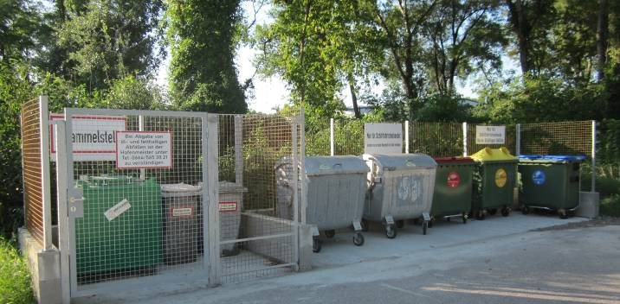
Objectives of CO-WANDA
Improvement of Ship Waste Management
    Waste Prevention & Pretreatment
    Network of Waste Reception Facilities
    Financing Model
Pilottests
  Electronic Vignette System in AT, SK, HU, HR, RO, BG
  River Information Services in HU, RO, RS
  Connect Maritime Danube Ports in RO (Galati, Tulcea)
International Danube Ship Waste Convention
Technical Part
Legal-Administrative Part

Slide 12

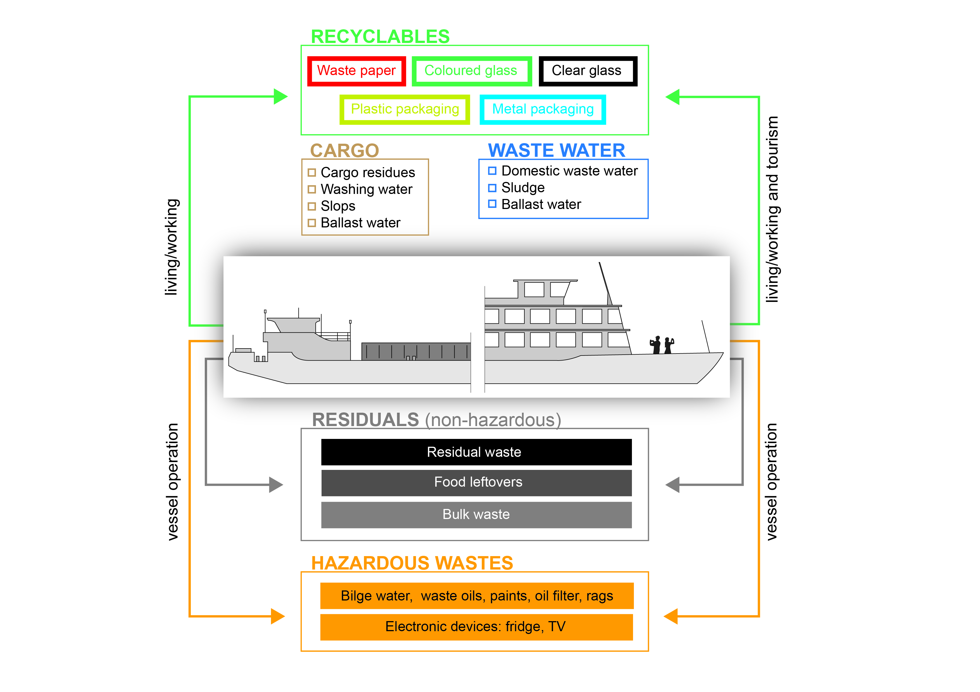
Waste Prevention & Pre-treatment
Cargo related
Living
Working
Tourism
Operation
Maintenance

Slide 13
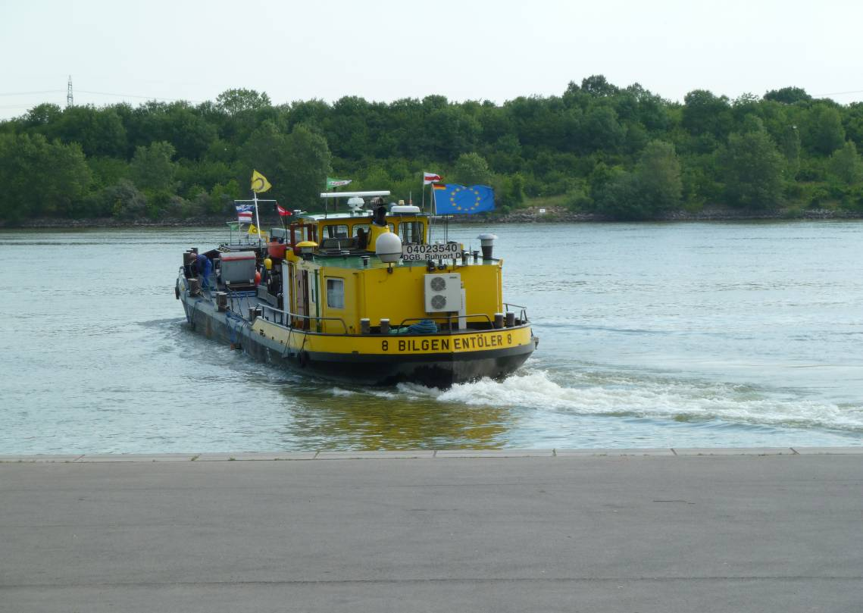
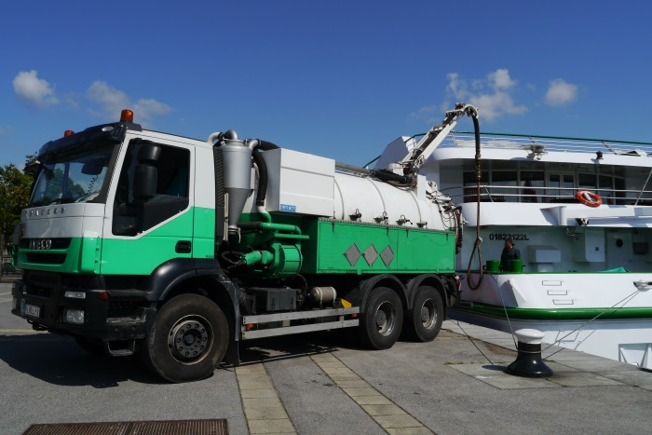
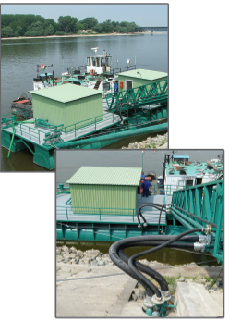
Network of WRFs
Types of WRFs
Waste Collection Vessels
Suction Trucks
Onshore stations
Criteria for Assessement:
Availability, pre-announcement time, adapability in the future, costs
modified
Cost-effectiveness analysis

Slide 14
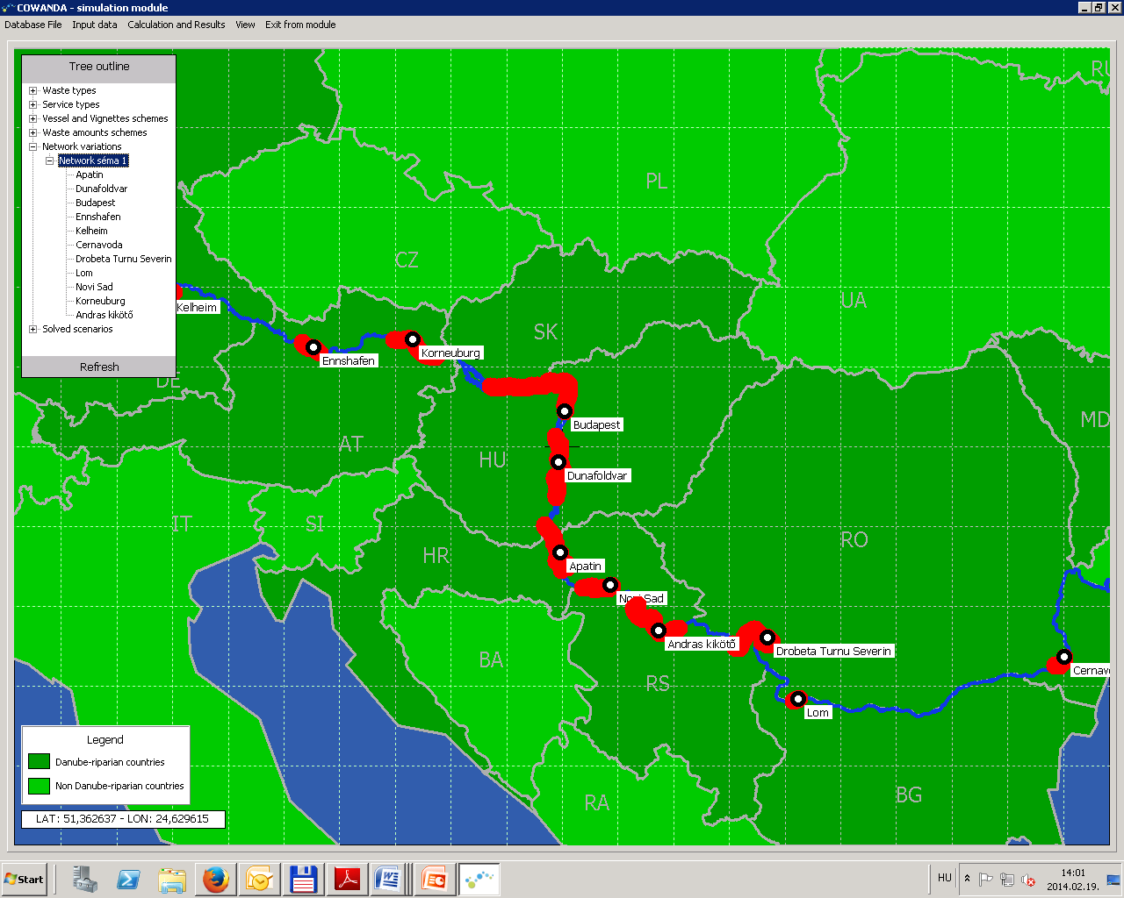
Network of WRFs
Goal: to define sufficient-dense, modern network to ensure transnational & barrier-free disposal services for low operational cost
Governing factors:
type and cost of services
number of WRFs
capacity utilization of WRFs
vessels’ number
waste amounts
Notes:
most of the input parameters mentioned were researched in the project, however uncertainty and lack of data exists

Slide 15

Financing Model for Oily and Greasy Ship Waste
…cost coverage
…international level
…simple, robust, cost efficient
…compatibel with Rhine System (gas oil fee)
Legal Frame Conditions
(EU, national, international)
Polluter Pays Principle
Indirect Payment
Waste Prevention
Notes:
15

Slide 16

Electronic Vignette System
A Vignette System has been suggested as most feasible solution for the Danube
CO-WANDA project
an Electronic Vignette System was developed and tested

Slide 17
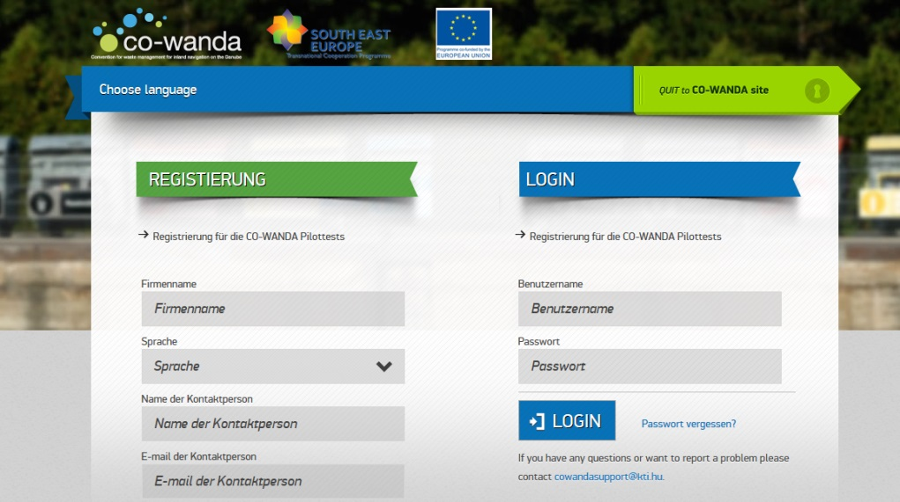
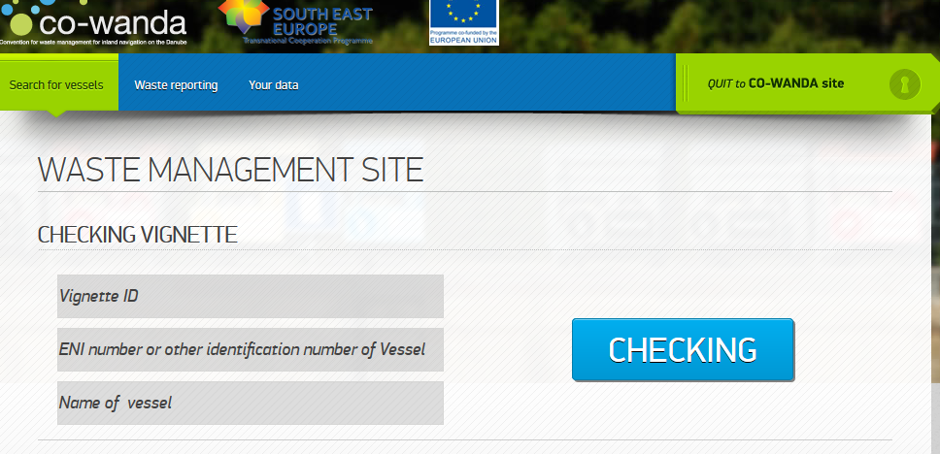
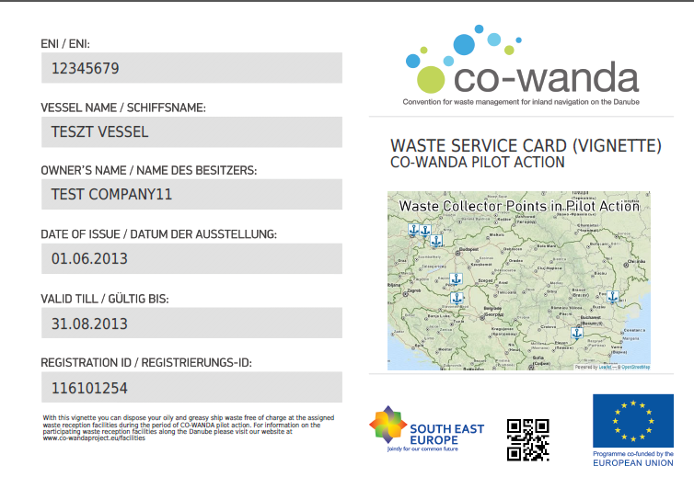
Electronic Vignette System
7 languages: EN, GE, SK, HU, HR, RO, BG
In 8 weeks, > 150 vessels registered for a vignette
Bilge water: > 400.000 l, Waste oil: > 23.000 l, Solid oily and greasy ship waste: > 2.000 kg
https://co-wandaproject.eu/pilotaction/

Slide 18
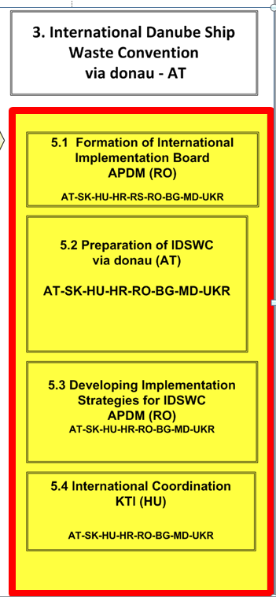
Development of the Int´l Danube Ship Waste Convention
4 step approach
Formation of an International Implementation Board: 27.2.2013
  Preparation of the Convention
  Strategies for Implementation
  International Coordination & Harmonisation
September 2014

Slide 19
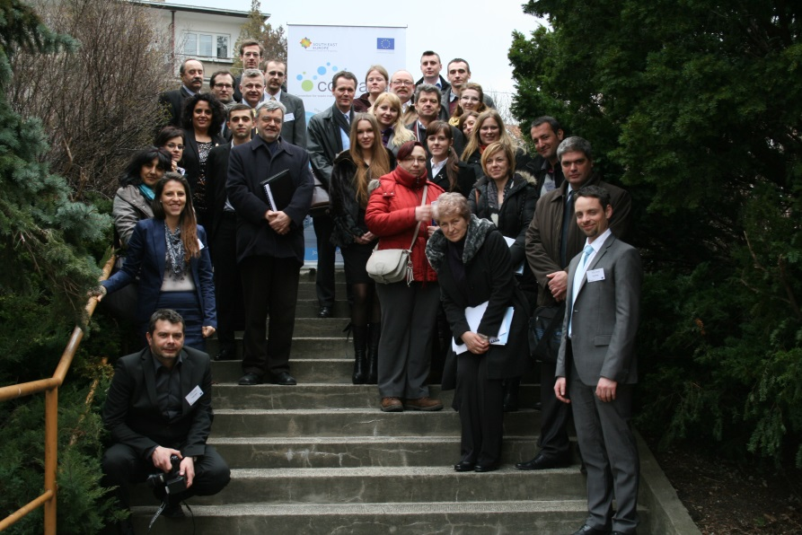
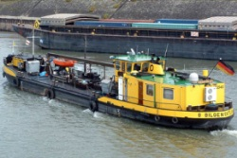





The International Implementation Board (1)
Goal:
Support Project Team
Give feedback to Ship Waste Convention
„Take over the Convention“ after the project has ended
1st Meeting: 27.2. – Budapest
2nd Meeting: 25.2. – Bratislava
3rd Meeting: 9.7. - Vienna
International Implementation
Board
International
Experts
National Experts - Ministries

Slide 20
Project Progress
2012
Project Start
2013
1st IIB Meeting
2014
Study Visit to Rhine Region
Pilot Tests & Investigations
Draft Convention
Processing of Data
Update of Convention
Finalise technical concepts
3rd IIB Meeting – 9.7.2014
Final Convention
Final Project Event: 9.9.2014 - HU
2nd IIB Meeting
Implementation Strategies
Technical conceptions
Establishing contacts to stakeholders
Start of negotiation phase
Project End
19./20.6. ICPDR

Slide 21
Conclusions
International coordination on operational level is necessary.
Streamlining of national processes will lead to a redistribution of financial contributions.
Goals can be reached stepwise.
Contributions of the participating States & support of European Union (?) will be required.

Slide 22
Course of action
25.2.2014
24.6.2014 (tbd)
Negotiation
International Danube Ship Waste Convention
Inputs from IIB
Implementation Strategies
Implementation
International Danube Ship Waste Convention
Project
End
September 2014
Technical Input
Waste Prevention, Infrastructure Development, Financing Model, RIS
Pilot data
Skippers Participation

Slide 23
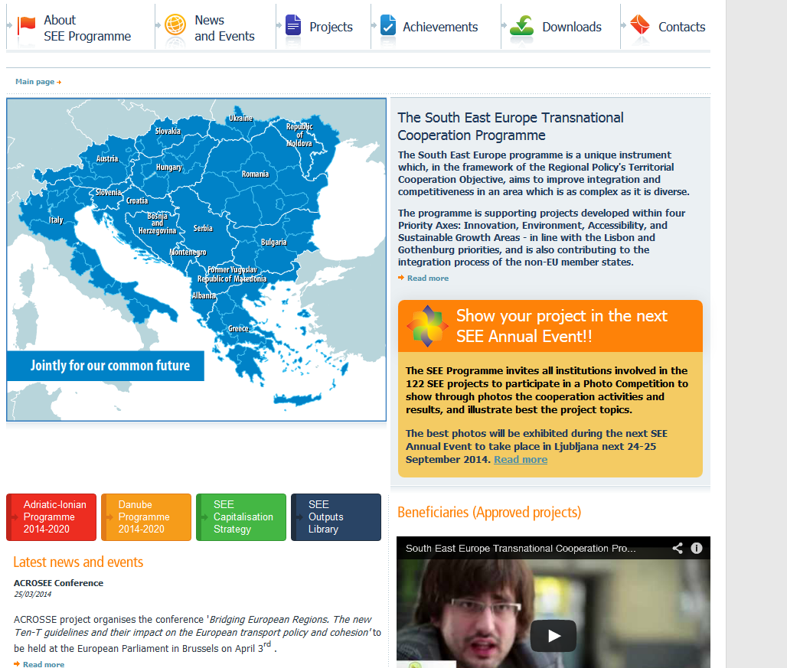
SEE Programme
Visit: http://www.southeast-europe.net/en

Slide 24

DANUBE PROGRAMME 2014+
The Danube Programme 2014-2020 will support the development and implementation of the Macro Regional Strategy for the Danube.

Slide 25

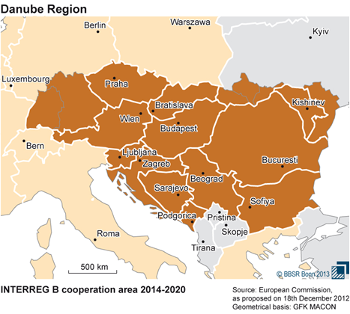
DANUBE PROGRAMME 2014+
The Danube Programme will cover parts of (…)
9 EU countries (Germany, Austria, Hungary, Czech Republic, Slovak Republic, Slovenia, Bulgaria, Romania and Croatia) and
5 non-EU countries (Serbia, Bosnia and Herzegovina, Montenegro, Ukraine and Moldova).
Source: http://www.southeast-europe.net/en/about_see/danubeprogramme/index

Slide 26
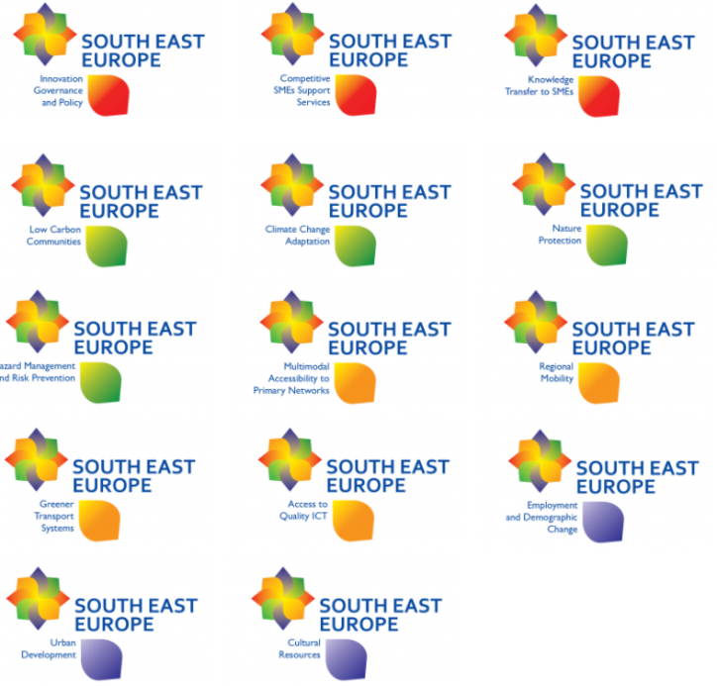
SEE Thematic Poles
Contribution to future programmes
Cooperation of projects
  14 POLEs
  POLE-9 is lead by CO-WANDA
Outcomes of the POLEs
  Road maps
  Workshops (RO, HR,…)
  Websites
  Platform for Project Development: 24.4.2014, Budapest
Source: http://www.southeast-europe.net/en/
„Green POLEs“
Low Carbon Communities, Climate Change Adaptation, Nature Protection, Hazard Management and Risk Protection, Green Transport Systems etc.

Slide 27
Thank you very much for your attention!
Hans Berger
hans.berger@viadonau.org
Belgrade, 27.03.2014

